Slide 1
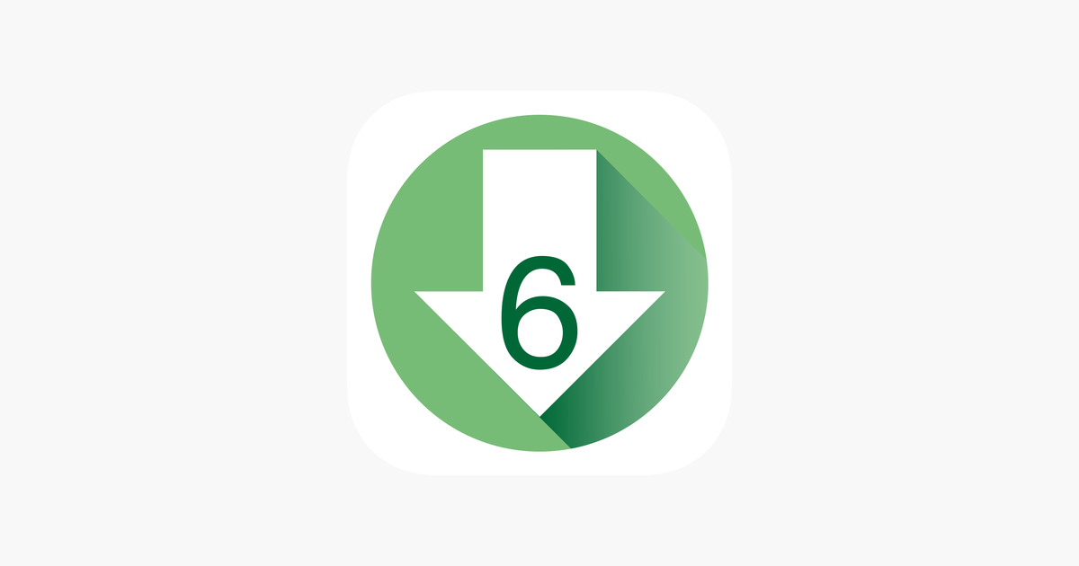
LOWER 6 APP
HOW DOES IT WORK?
HOW DOES IT WORK?

Slide 2
TOPICS
1) How to prepare a low glycemic indexed meal.(RECIPE)
2) How to purchase already prepared low glycemic indexed foods in your local area.
3) How can you expand your choices of healthy tasting foods.
4) How to look up a food manufacturer and the low glycemic foods they offer.

Slide 3
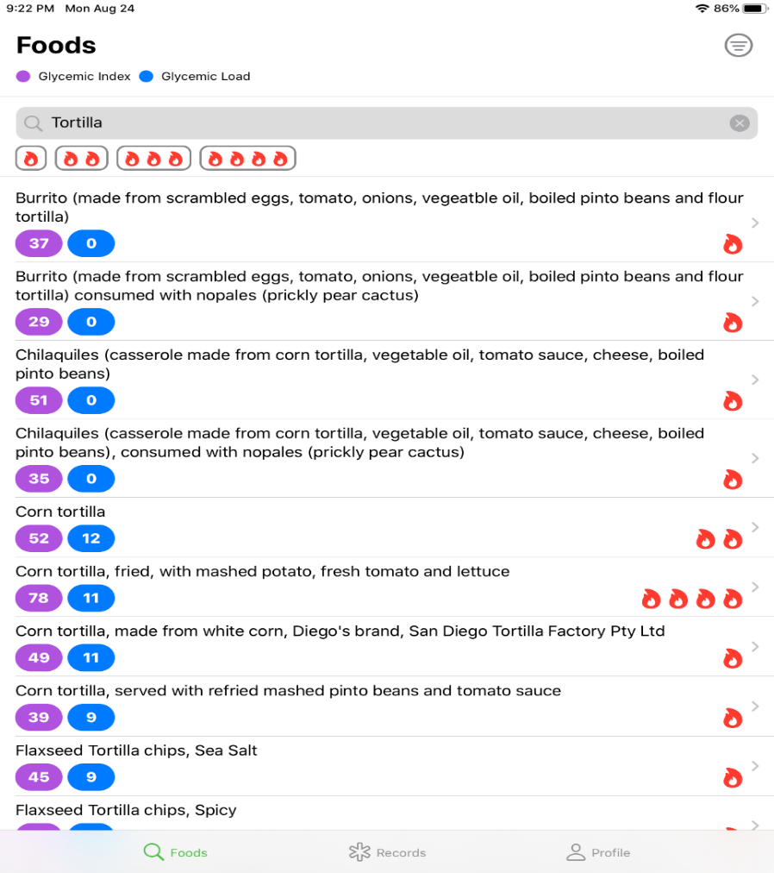
How to prepare a low glycemic indexed meal. (RECIPES)
1. Enter TORTILLA in the search window.

Slide 4
The results for TORTILLAS are grouped by SIMILAR FLAVOR and GLYCEMIC INDEX are displayed. (FLAMES)

Slide 5
The results for TORTILLAS are grouped by SIMILAR FLAVOR and GLYCEMIC INDEX are displayed. (FLAMES)
If you would like to eat a CORN FLAVORED tortilla that is LOW glycemic index then click on the box and discover the information.

Slide 6
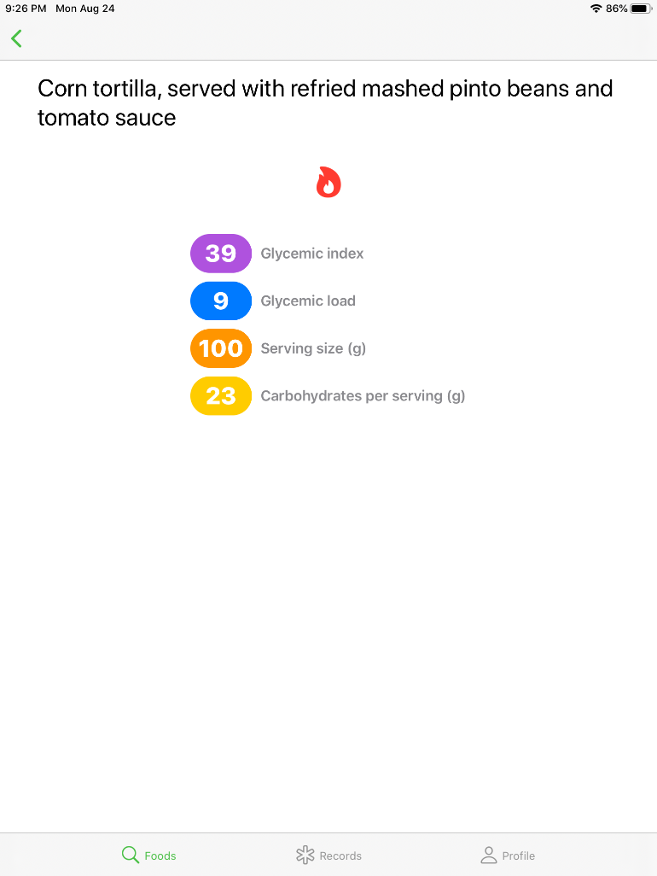
One Flame Recipe (No food Manufacturer listed)
In this case the app displays a RECIPIE because no food manufactrer is listed. Eat a “corn tortilla, served with refried mashed pinto beans and toato sauce.” (Low glycemic index)

Slide 7
The same FOOD, the same FLAVOR but a high glycemic index food. (4 flames)
Click the box that displays the corn flavored tortilla with 4 flames, (High Glycemic Index), and let us see what it says.

Slide 8
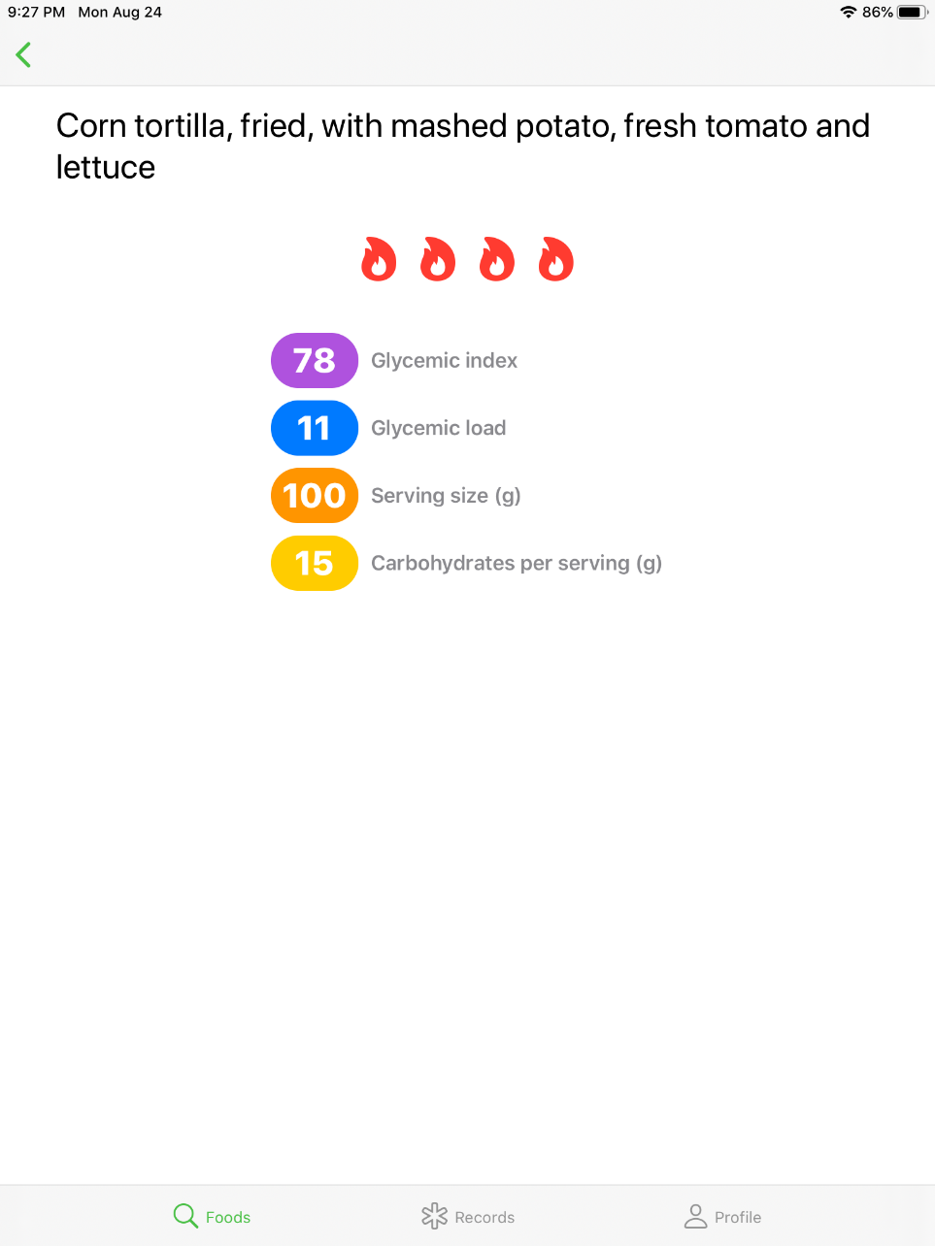
A high glycemic index RECIPIE
The app tells us that if we FRY the corn tortilla and serve it with mashed potato, fresh tomato and lettuce, the meal is now a HIGH GLYCEMIC indexed meal.

Slide 9
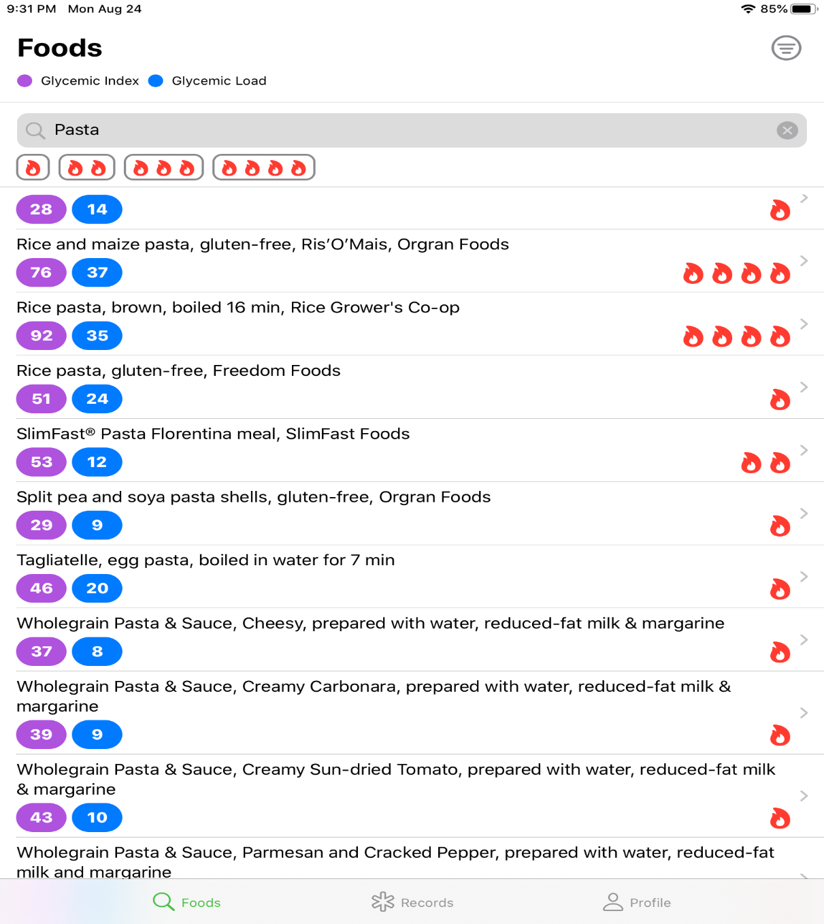
How to purchase already prepared low glycemic indexed foods in your local area.
For example, enter pasta in
the search window.

Slide 10
Lets say you want to eat RICE FLAVORED PASTA, that is LOW GLYCEMIC INDEXED
Click on the box listing rice flavored pasta, low glycemic indexed meal. (1 flame)

Slide 11
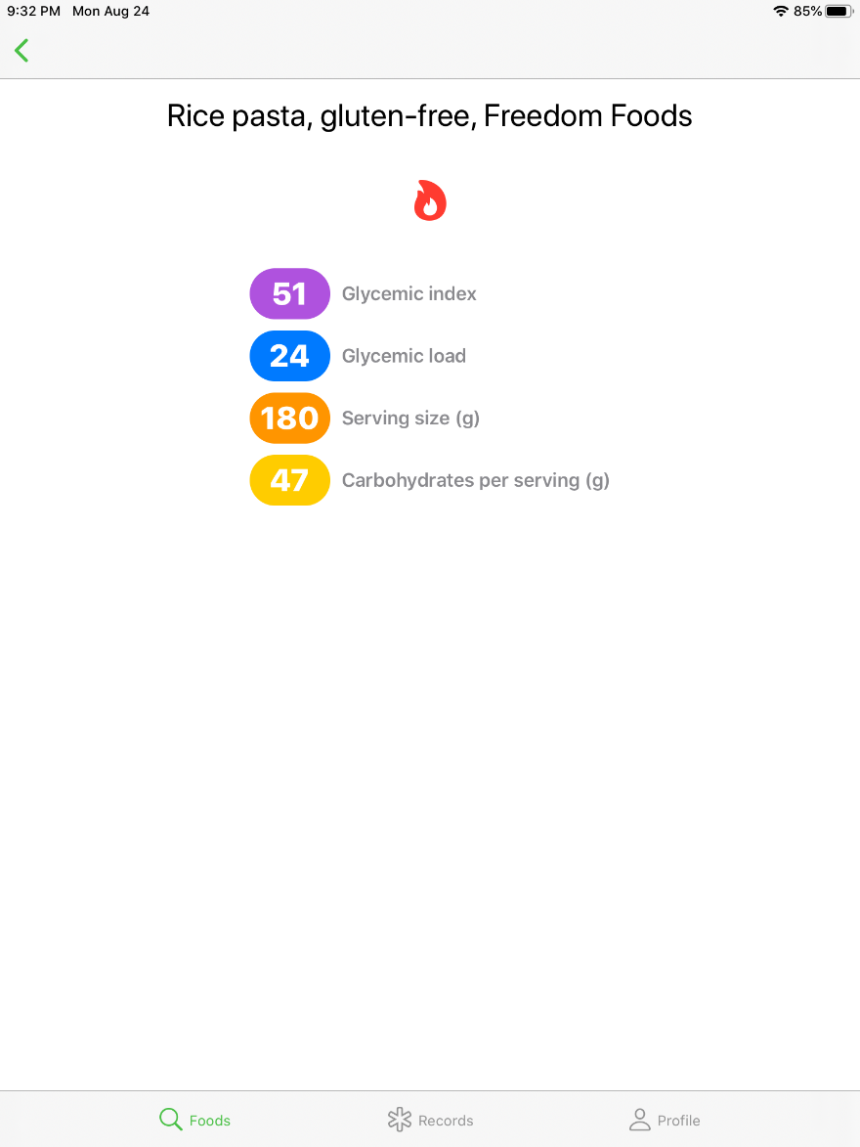
The app suggest that this is not a RECIPE but a FOOD FOR PURCHASE. (Freedom Foods is the MANUFACTURER)
Food for PURCHASE

Slide 12
I can go to any internet search engine and type in the following;
Where can I find Rice Flavored Pasta, gluten free made by FREEDOM FOODS…

Slide 13
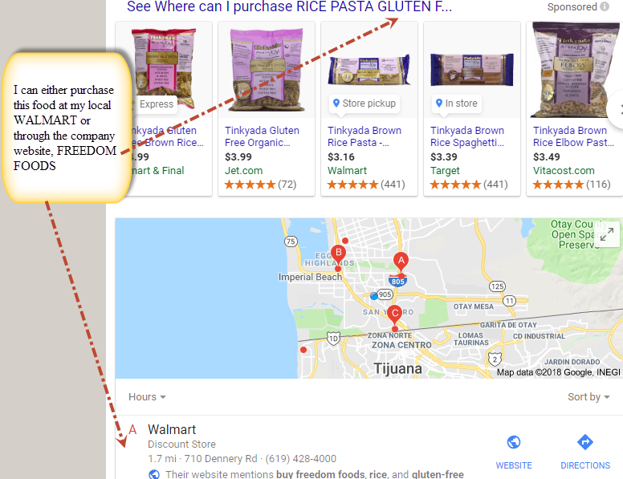
Or, where can I purchase

Slide 14
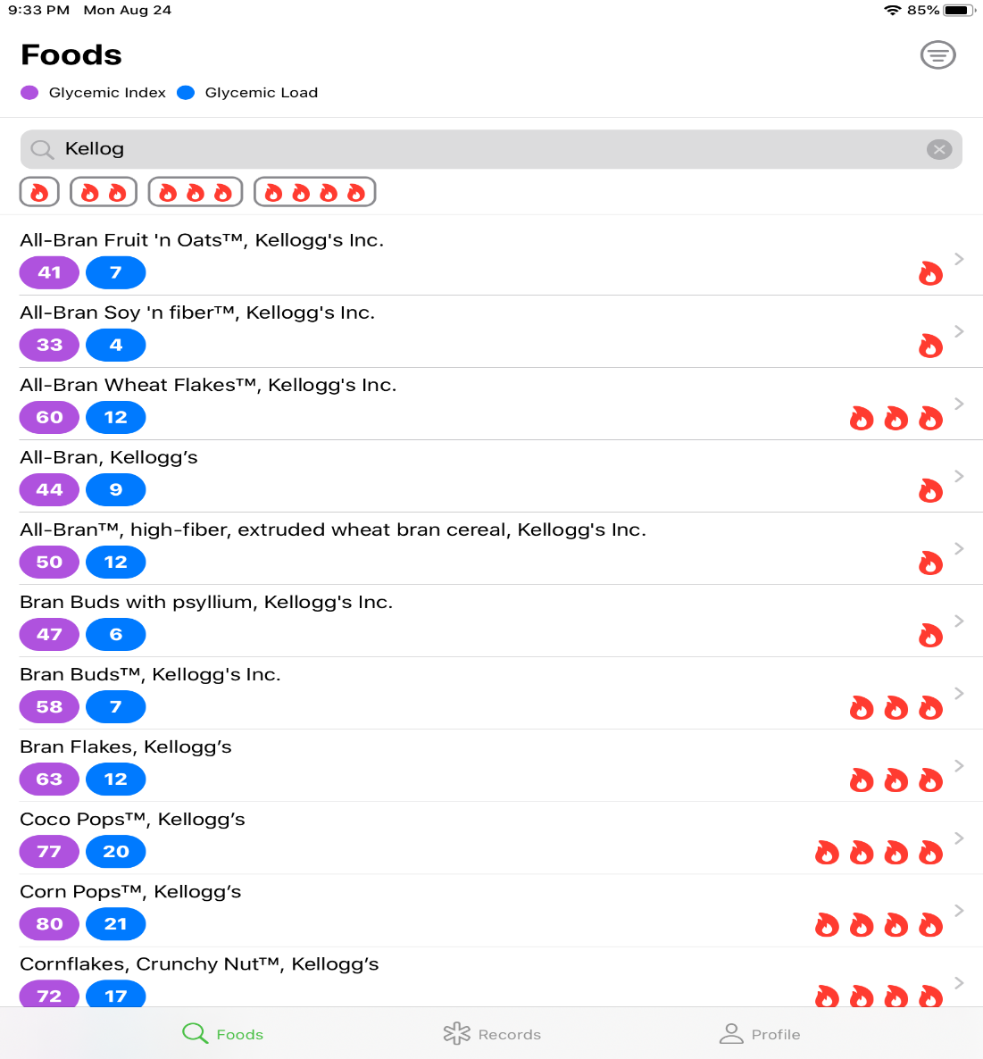
Lets say we want to look up foods manufactured by KELLOGG.
Enter the name of the manufacturer in search.

Slide 15
The app displays the flavor and glycemic index of foods produced by KELLOGG

Slide 16
How can you expand your choices of healthy tasting foods?
Lets say I did not enjoy the flavor of any 1 flame food, very low glycemic index pasta suggested by the APP even though I tried different flavors in that glycemic index range.
You have the option of entering a food and clicking on 2 flames or 3 flames to find other options.
Remember the goal is not FORCING you to eat certain foods but giving you the FREEDOM to find good tasting healthy food which YOU ENJOY EATING.

Slide 17
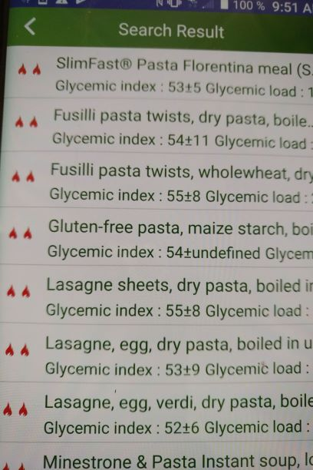
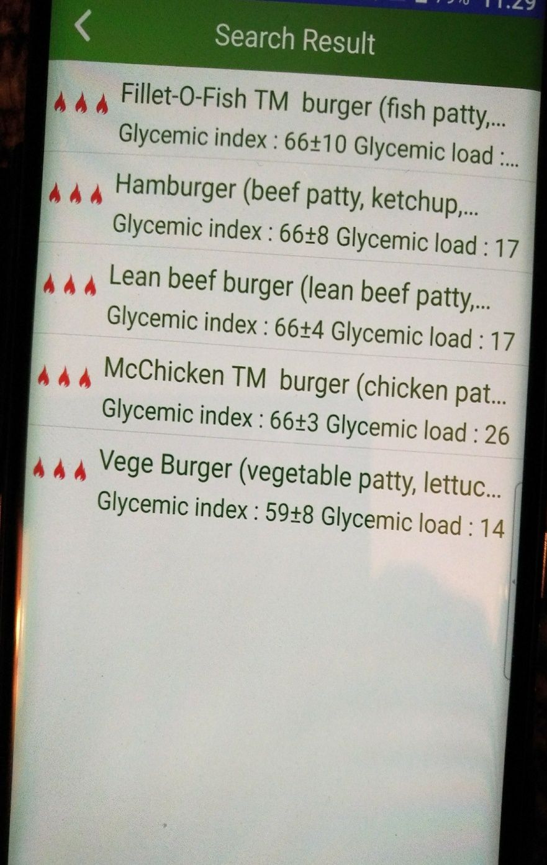

Slide 18
With the Lower 6 phone app your ADDITIONAL PHARMACY and NEW MEDICATION now become………….

Slide 19
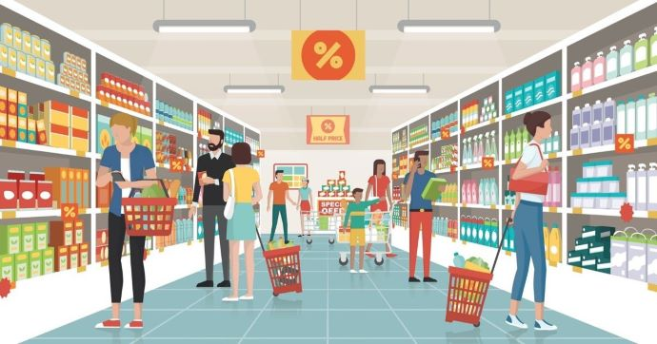
Your GROCERY STORE and FOOD

Slide 20
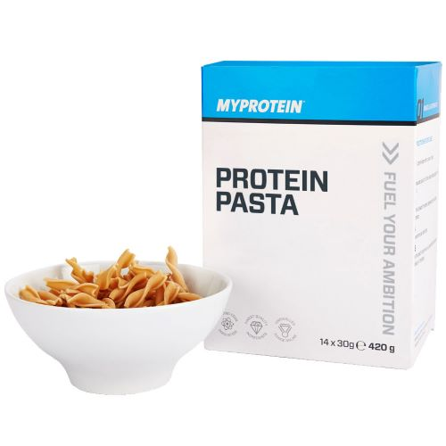
PATIENTS are not always COMPLIANT with TAKING MEDICATIONS but PEOPLE are always COMPLIANT with EATING FOOD. www.lower6app.com

